Slide 1
9 Hypothesis Testing
Business Statistics:
Communicating with Numbers, 4e
By Sanjiv Jaggia and Alison Kelly
Copyright 2022 © McGraw Hill LLC. All rights reserved. No reproduction or distribution without the prior written consent of McGraw Hill LLC.

Slide 2
Chapter 9 Learning Objectives (L Os)
L O 9.1 Define the null hypothesis and the alternative hypothesis.
L O 9.2 Distinguish between Type I and Type II errors.
L O 9.3 Conduct a hypothesis test for the population mean when σ is known.
L O 9.4 Conduct a hypothesis test for the population mean when σ is unknown.
L O 9.5 Conduct a hypothesis test for the population proportion.

Slide 3
Introductory Case: Undergraduate Study Habits 1
Are today’s college students studying hard or hardly studying?
A recent study asserts that, over the past five decades, the number of hours that the average college student studies each week has been steadily dropping (The Boston Globe, July 4, 2010).
In 1961, students invested 24 hours per week in their academic pursuits, whereas today’s students study an average of 14 hours per week.

Slide 4
Introductory Case: Undergraduate Study Habits 2
As dean of a large university in California, Susan Knight, wonders if the study trend is reflective of students at her university.
Susan randomly selected 35 students to ask about their average study time per week. Using these results, Susan wants to:
Determine if the mean study time of students at her university is below the 1961 national average of 24 hours per week.
Determine if the mean study time of students at her university differs from today’s national average of 14 hours per week.

Slide 5
9.1 Introduction to Hypothesis Testing 1
We have used sample information to make inference about a population parameter using a confidence interval.
Suppose you formulate a belief.
Conjecture or informed guess.
Proposition advanced as true tentatively.
A formulated believe is a hypothesis.
Every hypothesis confronts evidence that either substantiates or refutes it.
Determining the validity of an assumption is called hypothesis testing.
Hypothesis testing is the second type of inferences we can make about population parameters.

Slide 6
9.1 Introduction to Hypothesis Testing 2
Hypothesis testing is used to resolve conflicts between two competing hypothesis on a particular population of interest.
One hypothesis is the null hypothesis.
Denoted H₀.
Presumed default state of nature or status quo.
The other hypothesis is the alternative hypothesis.
Denoted H_{A}.
Contradicts default state of nature or status quo.
We conduct a hypothesis test to determine whether or not sample evidence contradicts H₀.
Our goal is to determine if the null hypothesis can be rejected.

Slide 7
9.1 Introduction to Hypothesis Testing 3
We can make one of two decisions.
Reject the null hypothesis.
Do not reject the null hypothesis.
Reject the null hypothesis when the sample evidence is inconsistent with the null hypothesis.
Criminal court: innocent.
Not evidence to convict.
Do not reject the null hypothesis when the sample evidence is not inconsistent with the null hypothesis.
Not correct that “we accept the null hypothesis”.
Sample information may not be inconsistent with the null.
But this does not prove the null hypothesis is true.
Criminal court: guilty, enough evidence to convict.

Slide 8
9.1 Introduction to Hypothesis Testing 4
A very crucial step in a hypothesis test concerns the formulation of the two competing hypotheses.
The conclusion of the test depends on how the hypotheses are stated.
Null hypothesis.
Status quo or “business as usual”.
Specified with =, ≤ or ≥.
Alternative hypothesis.
Contests status quo.
Whatever we wish to establish, something new.
Specified with the opposite of what is in the null: ≠, > or <.

Slide 9
9.1 Introduction to Hypothesis Testing 5
One-tailed tests use < or > in the alternative.
Two-tailed test uses ≠ in the alternative.
In general, we follow three steps when formulating the competing hypotheses.
Identify the relevant population parameter of interest.
Determine whether it is a one- or two-tailed test.
Include some form of the equality sign in the null hypothesis and use the alternative hypothesis to establish a claim.

Slide 10
9.1 Introduction to Hypothesis Testing 6
Example: A trade group predicts that back-to-school spending will average $606.40 per family this year. A different economic model is needed if the prediction is wrong.
Parameter of interest is
since we are interested in the average
back-to-school spending.
Since we want to determine if the population mean differs from $606.40 (that is, ≠), it is a two-tail test.

Slide 11
9.1 Introduction to Hypothesis Testing 7
Example: A television research analyst wishes to test a claim that more than 50% of the households will tune in for a TV episode. Specify the null and the alternative hypotheses to test the claim.
Parameter of interest is p since we are interested in the proportion of households.
Since the analyst wants to determine whether p > 0.50, it is a one-tail test.

Slide 12
9.1 Introduction to Hypothesis Testing 8
The decision of a hypothesis test is based on limited sample information, we are bound to make errors.
Correct decisions:
Reject the null hypothesis when the null hypothesis is false.
Not reject the null hypothesis when the null hypothesis is true.
There are two types of errors:
Type I Error: reject the null hypothesis when it is true.
Type II Error: do not reject the null hypothesis when it is false.
Decision | Null hypothesis is true | Null hypothesis is false
Reject the null hypothesis | Type I error | Correct decision
Do not reject the null hypothesis | Correct decision | Type II error

Slide 13
9.1 Introduction to Hypothesis Testing 9
Not always easy to determine which of the two errors has more serious consequences.
For given evidence, there is a trade-off between these errors.
By reducing the likelihood of a Type I error, we implicitly increase the likelihood of a Type II error, and vice versa.
The only way we can reduce both errors is by collecting more evidence.
Denote a Type I error with
Denote a Type II error with

Slide 14
9.1 Introduction to Hypothesis Testing 10
The only way we can lower both
is by increasing n.
For a given n:
We can reduce
Reduce
The optimal choice of
depends on the relative cost of these two types
of errors.
Determining these costs is not always easy.
Typically, the decision regarding the optimal level of Type I and Type II errors is made by the management of a firm.
The job of a statistician is to conduct the hypothesis test for a chosen value of

Slide 15
9.2 Hypothesis Test for the Population Mean when Sigma is Known 1
We introduce the basic methodology for hypothesis testing in this context.
It is true that
is rarely known.
Instances where
is stable and can be determined from prior experience.
In these cases, treat
as known.
This does not change the general procedure or principles.
Assume the null hypothesis is true.
Then determine if the sample evidence contradicts this assumption.
Criminal court: the individual is innocent until proven guilty.
Two Approaches.
P-value: reported by statistical software, used by researchers.
Critical value: computer is not available, overview in appendix.

Slide 16
9.2 Hypothesis Test for the Population Mean when Sigma is Known 2
A test about
Essential that the sampling distribution of
is (approximately) normal
(underlying population is normal or n ≥ 30).
Let
be the hypothesized value of the population mean.
A large difference between
does not mean the null hypothesis is
false, it could be explained by chance.

Slide 17
9.2 Hypothesis Test for the Population Mean when Sigma is Known 3
The test statistic accounts for the variability and is evaluated at
Use the test statistic to find the p-value.

Slide 18
9.2 Hypothesis Test for the Population Mean when Sigma is Known 4
The p-value is the likelihood of obtaining a sample mean that is at least as extreme as the one derived from the sample, assuming the null hypothesis is true
Define the allowed probability of making a Type I error as
is the significance level.
Choose
before implementing a test.
Typically

Slide 19
9.2 Hypothesis Test for the Population Mean when Sigma is Known 5
The p-value is the observed probability of making a Type I error.
Use the p-value to make the decision.
Reject the null hypothesis if the
Do not reject the null hypothesis if the

Slide 20
9.2 Hypothesis Test for the Population Mean when Sigma is Known 6
The p-value depends on the specification of the alternative hypothesis.
is the hypothesized value of the population mean.
is the test statistic.

Slide 21
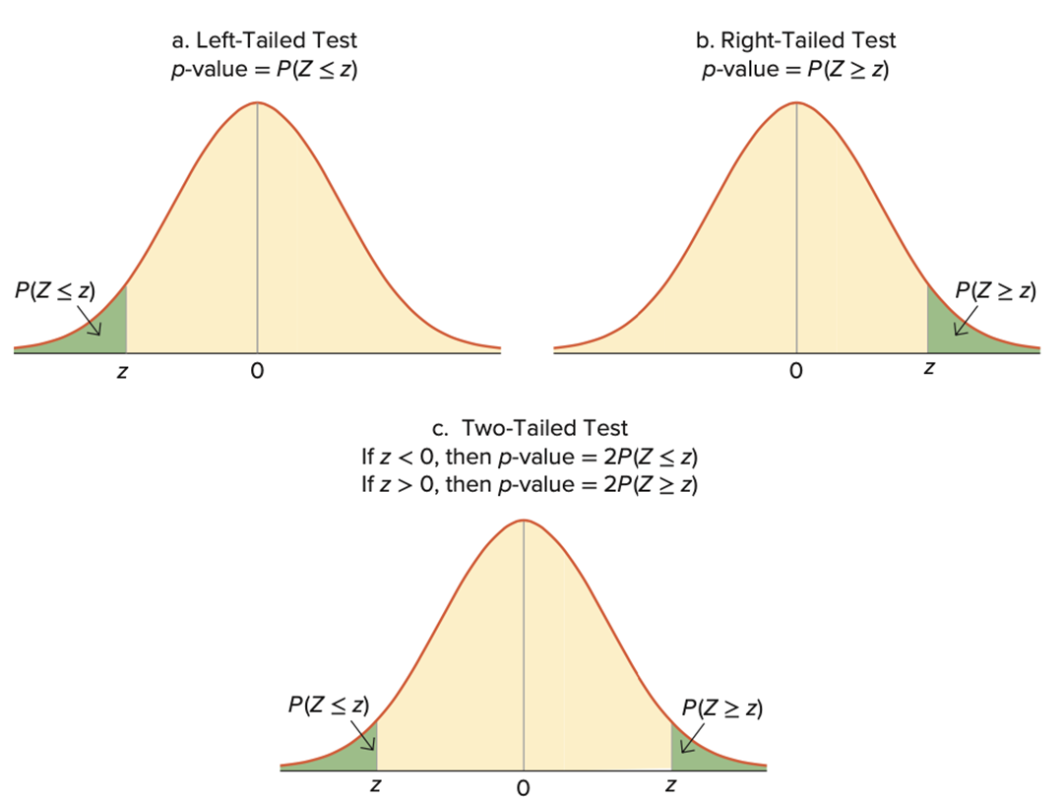
9.2 Hypothesis Test for the Population Mean when Sigma is Known 7
Access the text alternative for slide images.

Slide 22
9.2 Hypothesis Test for the Population Mean when Sigma is Known 8
Four-step procedure approach:
Specify the null and the alternative hypotheses.
Specify the significance level.
Calculate the test statistic and the p-value.
State the conclusion and interpret the results.
It is important to clearly communicate the results.
Not sufficient to end the analysis with the conclusion of reject or not.
Interpret the results for the claim regarding the population parameter.

Slide 23
9.2 Hypothesis Test for the Population Mean when Sigma is Known 9
Example: A sample of 30 households showed that the sample mean of back-to-school spending is $622.85.
It is believed that back-to-school spending is normally distributed with a population standard deviation of $65.
An analyst wishes to test if the average back-to-school spending differ from $606.40 per family predicted by the trade group at the 5% significance level.
Step 1: Specify the null and alternative hypotheses.
Step 2: Specify the significance level;

Slide 24
9.2 Hypothesis Test for the Population Mean when Sigma is Known 10
Step 3: Calculate the test statistic and the p-value.
For a two-tailed test, the p-value is
The p-value is 2 × 0.0823 = 0.1646.
Step 4: State the conclusion and interpret the results.
Since 0.1646 > 0.05, do not reject the null hypothesis.
At the 5% significance level, we cannot conclude that average back-to-school pending differs from $606.40 per family this year.
The sample data do not support the research analysts claims.

Slide 25
9.2 Hypothesis Test for the Population Mean when Sigma is Known 11
Recall the confidence interval for
The confidence interval is sometimes used for conducting a two-tailed hypothesis test.
For
Reject H₀ if
does not fall within the confidence interval.
Do not reject H₀ if
falls within the confidence interval.

Slide 26
9.2 Hypothesis Test for the Population Mean when Sigma is Known 12
Example: A researcher believes the average net work of millennials is less than $8,000.
She surveys 40 millennials and determines their net worth.
Net Worth
7960
7700
…
7023
It is assumed that the population standard deviation is $500 and that net worth is normally distributed.
Test the claim at the 1% significance level.

Slide 27
9.2 Hypothesis Test for the Population Mean when Sigma is Known 13
Example, continued.
Step 1: Specify the null and alternative hypotheses.
Step 2: Specify the significance level;
Step 3: Calculate the test statistic and the p-value.
Excel: use the functions AVERAGE, SQRT, NORM.DIST.
Test statistic is −2.3673, p-value is 0.009.

Slide 28
9.2 Hypothesis Test for the Population Mean when Sigma is Known 14
Step 3: Calculate the test statistic and the p-value.
R: use the functions mean, sqrt, pnorm.
Test statistic is −2.367281, p-value is 0.008959659.
Step 4: State the conclusion and interpret the results.
Since 0.009 < 0.01, reject the null hypothesis.
At the 1% significance level, the researcher can conclude that the average net worth of millennials is less than $8,000.
Access the text alternative for slide images.

Slide 29
9.3 Hypothesis Test for the Population Mean when Sigma is Unknown 1
In most applications, is
not known.
Replace
with the sample standard deviation s to estimate the
standard error of
Essential the sampling distribution of
is (approximately) normal
(underlying population is normal or n ≥ 30).
Let
be the hypothesized mean.
The test statistic is

Slide 30
9.3 Hypothesis Test for the Population Mean when Sigma is Unknown 2
Example: Recall the introductory case. The dean randomly selects 35 students and asks their average study time per week (in hours).
From their responses, she calculates a sample mean of 16.3714 hours and a sample standard deviation of 7.2155 hours.
The dean would also like to test if the mean study time of students at her university differs from today’s national average of 14 hours per week.
At the 5% significance level, what is the conclusion to this test?

Slide 31
9.3 Hypothesis Test for the Population Mean when Sigma is Unknown 3
Example, continued.
Step 1: Specify the null and alternative hypotheses.
Step 2: Specify the significance level;
Step 3: Calculate the test statistic and the p-value.
Excel: use the functions AVERAGE, STDEV.S, SQRT, T.DIST.RT.
Test statistic is 1.9444, p-value is 0.0602.

Slide 32
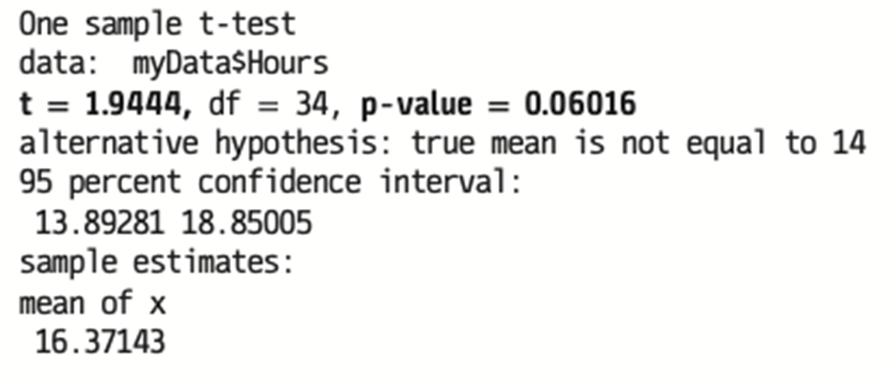
9.3 Hypothesis Test for the Population Mean when Sigma is Unknown 4
Example, continued.
Step 3: calculate the test statistic and the p-value.
R: use the function t.test.
R output.
Access the text alternative for slide images.

Slide 33
9.3 Hypothesis Test for the Population Mean when Sigma is Unknown 5
Example, continued.
Step 4: State the conclusion and interpret the results.
Since 0.0602 > 0.05, do not reject the null hypothesis.
At the 5% significance level, we cannot conclude that the mean study time of students at this large university in California differs from 14 hours per week.

Slide 34
9.4 Hypothesis Test for the Population Mean Proportion 1
The population proportion p represents the proportion of observations with a particular attribute.
Estimate the population proportion using the sample proportion,
has an approximate normal distribution when
Let p₀ be the hypothesized value of the population proportion in the null hypothesis.
The test statistic is

Slide 35
9.4 Hypothesis Test for the Population Mean Proportion 2
Example: Driven by growing public support, the legalization of marijuana in America has been moving at a very rapid rate.
Today, 57% of adults say the use of marijuana should be made legal.
A health practitioner in Ohio collects data from 200 adults and finds that 102 of them favor marijuana legalization.
a. The health practitioner believes that the proportion of adults who favor marijuana legalization in Ohio is not representative of the national proportion. Specify the competing hypotheses to test her claim.
b. Calculate the value of the test statistic and the p-value.
c. At the 10% significance level, do the sample data support the health practitioner’s belief?

Slide 36
9.4 Hypothesis Test for the Population Mean Proportion 3
Example, continued.
a. The hypotheses are
b.
The p-value is
c. Because the p-value of 0.0872 is less than
we reject the null
hypothesis. Therefore, at the 10% significance level, the proportion of adults who favor marijuana legalization in Ohio differs from the national proportion of 0.57.

Slide 37
End of Main Content
Copyright 2022 © McGraw Hill LLC. All rights reserved. No reproduction or distribution without the prior written consent of McGraw Hill LLC.

Slide 38
Accessibility Content: Text Alternatives for Images

Slide 39
9.2 Hypothesis Test for the Population Mean when Sigma is Known 7 – Text Alternative
Return to parent-slide containing images.
The left-tailed test for p value = P (Z less than or equal to z): shows a normal curve in which the left tail is shaded, which indicates the p-value as P (Z less than or equal to z). The right-tailed test for p value = P (Z greater than or equal to z): shows a normal curve in which the right tail is shaded, which indicates the p-value as P (Z greater than or equal to z). The third two tailed test for: if z less than 0, then p value = 2 P (Z less than or equal to z) or if z greater than 0, then p value = 2 P (Z greater than or equal to z). The graph shows a normal curve for which both the right and left tails are shaded, left tail value P (Z less than or equal to z); right tail value P (Z greater than or equal to z), which indicates a two-tailed test.
Return to parent-slide containing images.

Slide 40
9.2 Hypothesis Test for the Population Mean when Sigma is Known 14 – Text Alternative
Return to parent-slide containing images.
For first image, program code. In the code, the words in the variable names are merged. Line 1. > Teststat, <, hypen, left parenthesis, mean, left parenthesis, myDatedollar, open single quotes, Net worth, close single quotes, right parenthesis, hypen, 8000, right parenthesis, over, left parenthesis, 500, over, sqrt, left parenthesis, 40, right parenthesis, right parenthesis. Line 2. > list, left parenthesis, Teststat, right parenthesis.
For second image, program code. In the code, the words in the variable names are merged. Line 1. pnorm, left parenthesis, Teststat, comma, 0, comma, 1, lower.tail = True, right parenthesis.
Return to parent-slide containing images.

Slide 41
9.3 Hypothesis Test for the Population Mean when Sigma is Unknown 4 – Text Alternative
Return to parent-slide containing images.
For first image, program code. In the code, the words in the variable names are merged. Line 1. > t.test, left parenthesis, mydatadollarHours, comma, alternative = open quotes, two.sided, close quotes, comma, mu = 14, right parenthesis.
For second image, program code. In the code, the words in the variable names are merged. Line 1. One sample t, hypen, test. Line 2. data, colon, myDatadollarHours. Line 3. t = 1.9444, comma, df = 34 comma, p, hypen, value = 0.06016. Line 4. alternative hypothesis, colon, true mean is not equal to 14. Line 5. 95 percent confidence interval, colon. Line 6. 13.89281 18.85005. Line 7. sample estimates, colon. Line 8. mean of x. Line 9. 16.37143.
Return to parent-slide containing images.

